Slide 1
BUSQOM 1080 Comparing Groups I
Fall 2020
Lecture 7
Professor: Michael Hamilton

Slide 2
Lecture Summary
Recap of previous summary methods on categorical data.
Making tables in R using table(). [5 Mins]
Fundamentals of hypothesis testing. [10 Mins]
Review the Chi-Squared Test. [5-10 Mins]
Example 1: Chi-Squared test on installed data using chisq.test(),
Review the Binomial Test. [5 Mins]
Example 2: Binomial test on installed data using binom.test()
Review the Test of Equal Proportions. [5 Mins]
Example 3: Test of Equal Proportions using prop.test()

Slide 3
Topic: Understanding Categorical Vars.
We learned some commands to get counts and proportions.
Example:
We can count the number of observations using length()
Compute proportions by summing logicals
flight_data = read.table("RegionEx_Data.txt", header = T, sep = "\t")
> airline = flight_data$Airline
> airline[1:10]
[1] RegionEx RegionEx RegionEx RegionEx …
length(airline)
[1] 360
sum(airline == "MDA")/length(airline)
[1] 0.3333333

Slide 4
Topic: Understanding Categorical Vars.
We can do this more easily using the table() command
Syntax: table() takes in one or more vectors of categorical data
Example:
We can perform operations on the output of table
Can also pass multiple vectors of categorical data
flight_data = read.table("RegionEx_Data.txt", header = T, sep = "\t")
table(flight_data$Airline)
MDA RegionEx 120 240
table(flight_data$Airline)/length(flight_data$Airline)
MDA RegionEx 0.3333333 0.6666667
table(flight_data$Airline, flight_data$Delay.indicator)
0 1
MDA 86 31
RegionEx 177 63

Slide 5
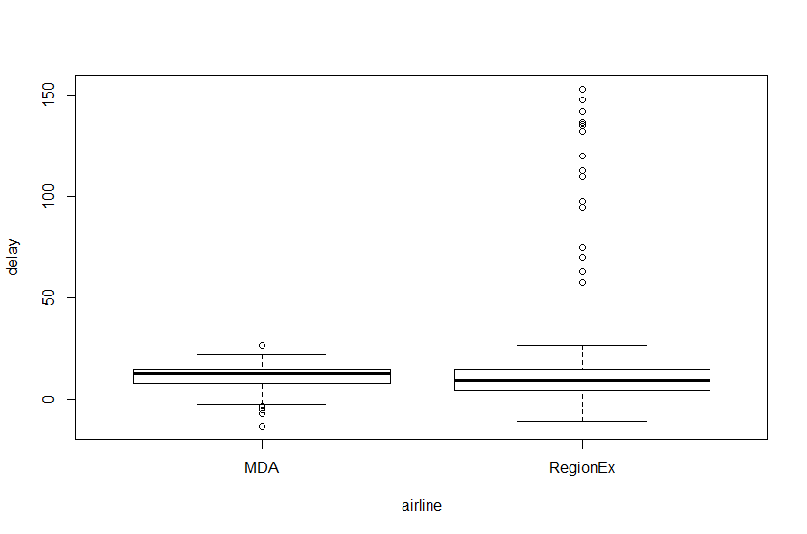
Comparing Groups with summary(), plots
We’ve also learned how to compare groups by computing summary statistics or plotting.
Example: What’s the relationship of Airline versus Arrival.delay?
delay= flight_data$Arrival.delay.in.minutes
summary(delay)
Min. 1st Qu. Median Mean 3rd Qu. Max. NA’s
-13.00 5.00 11.00 14.11 15.00 153.00 3
> boxplot(delay ~ airline)

Slide 6
What does this tell us?
RegionEx operated more flights than MDA (240 vs 120 flights)
RegionEx had more delayed flights than MDA (63 vs 31 flights)
Proportion of delayed flight approximately equal (~26% delayed)
RegionEx’s average flight delay is longer than MDA’s (~17 vs ~11 minutes)
RegionEx’s median flight delay is shorter than MDA’s (9 vs 13 minutes)
About 15 flights with extremely long delays drive the average up

Slide 7
Topic: Statistical Hypothesis Testing
Once we have a hypothesis, we can use statistics to test differences between groups.
We will compare groups by testing the differences between statistics.
Counts – chi.sq()
Proportions – binom.test(), prop.test()
Means – t.test(), ANOVA
We can determine if differences are “statistically significant”
Note: Statistical significance does not always imply practical significance
Note: Practical significance does not always imply statistical significance

Slide 8
Topic: Statistical Hypothesis Testing
Want to test if a result simply due to chance or due to deeper effect.
Hypothesis testing format:
State hypotheses
Null hypothesis: accepted truth, status quo, or no relationship between two variables
Alternative hypothesis: what we hypothesize, or a relationship between two variables
Use data to attempt to disprove the null hypothesis
Compute a test statistic (dependent on specific test, R will do this for us)
Compute the associated p-value (again, R will do this for us)
Draw conclusions based on result (usually using the p-value)

Slide 9
General Framework of Statistical Tests
Form hypotheses (null, alternative) + State assumptions
Observe a sample of data: X₁ , X₂ , … , X_{N}
Compute statistic: T = f(X₁ , X₂ , … , X_{N})
Based on the null hypothesis and possibly some assumptions about the data, derive the distribution of T, call it F. (T ~ F)
Use F to measure the probability of T occurring under the hypothesis.
This is called the p-value

Slide 10
p-values explained
The p-values is the probability of observing samples that are as least as extreme as observed, subject to assumptions + null hypothesis. (CDF of observed)
They are based on the idea of repeatedly taking samples of the same size from a population i.e. repeating experiments multiple time.
Example:
Randomly select 5 students in this class
Ask them how many contacts they have stored in their phone
Compute the average
Repeat…
It’s highly unlikely to get the same average value every time, but “most” should be “close” what’s expected

Slide 11
Interpreting p-values
Given a certain sample size (e.g., 5) and sample statistic (e.g., sample mean), the p-value tells us the probability that this result is just due to this random variation within the larger population
Example: Maybe I just happened to choose the 5 people with the most phone contacts
A large p-value suggests that the result was likely due to chance
A small p-value suggests that the result is not likely just chance
If the p-value is small enough, we say the result is “statistically significant”

Slide 12
Interpreting p-values, what is small enough?
Answer: It depends ☹
The specific cutoff (level of significance) can change on a case by case basis
Convention: Use 0.05 as the cutoff (level of significance)
If p-value > 0.05 ➔ not statistically significant
If p-value < 0.05 ➔ statistically significant
For this class we always report our p-values! Note just the cut-offs
If p-value > 0.10 ➔ not statistically significant
If 0.01 < p-value < 0.10 ➔ may or may not be statistically significant (grey area)
If p-value < 0.01 ➔ statistically significant

Slide 13
Topic: Testing Counts/Frequencies in R
Let’s do an example using the flight data.
First make a table displaying counts by day of the week:
Null Hypothesis: Flights are uniformly distributed through out the week.
Alternative Hypothesis: Flights are not uniformly distributed through out the week.
To test whether all of the days have the same frequencies we use the Pearson’s chi-squared test for count data.
day.counts = table(flight_data$Day.of.Week)
day.counts
1 2 3 4 5 6 7
48 60 60 48 48 48 48

Slide 14
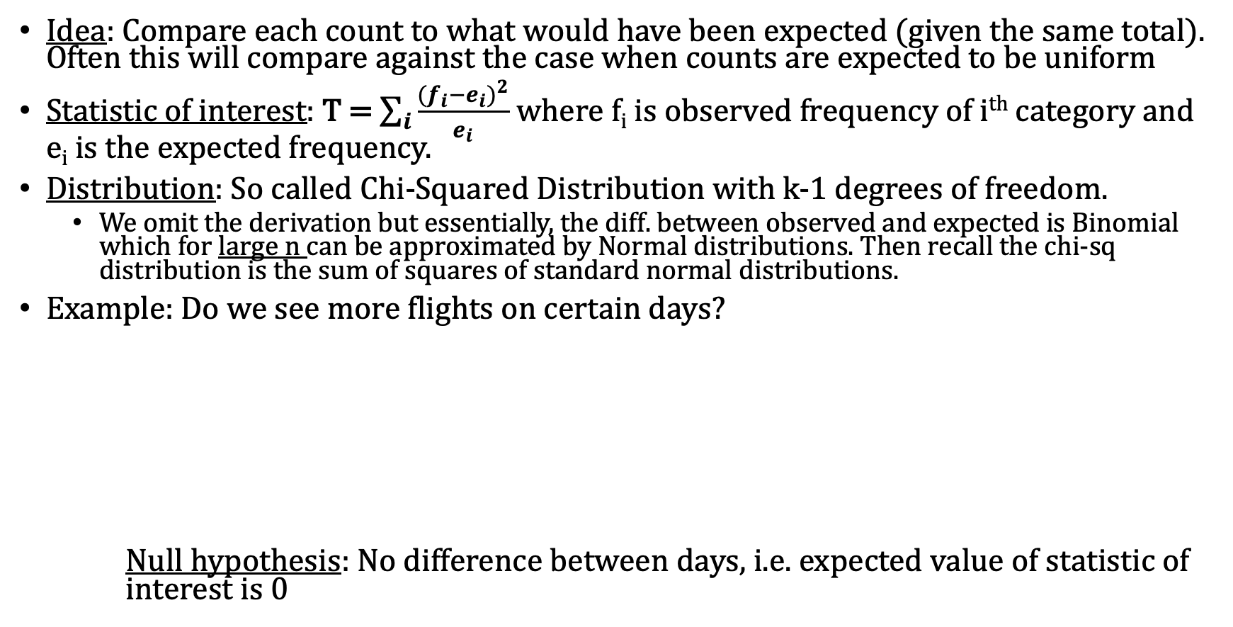
Topic: Chi-squared Test for Count Data
Idea: Compare each count to what would have been expected (given the same total). Often this will compare against the case when counts are expected to be uniform
Statistic of interest: T = $\sum_{i}{\frac{{{(f}_{i}−e_{i})}^{2}}{e_{i}}}$ where f_{i} is observed frequency of i^{th} category and e_{i} is the expected frequency.
Distribution: So called Chi-Squared Distribution with k-1 degrees of freedom.
We omit the derivation but essentially, the diff. between observed and expected is Binomial which for large n can be approximated by Normal distributions. Then recall the chi-sq distribution is the sum of squares of standard normal distributions.
Example: Do we see more flights on certain days?
Null hypothesis: No difference between days, i.e. expected value of statistic of interest is 0
 | Sunday | Monday | Tuesday | Wednesday | Thursday | Friday | Saturday | Total
Observed Data | 48 | 60 | 60 | 48 | 48 | 48 | 48 | 360
Expected Counts | 51.43 | 51.43 | 51.43 | 51.43 | 51.43 | 51.43 | 51.43 | 360
Alt Hyp: Some difference between days

Slide 15
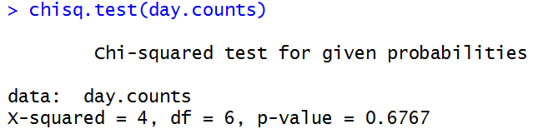
Performing a Chi-Square Test in R
Syntax: chisq.test(table_obs_counts)
Note the command automatically compares against uniform expected counts!
Single argument: a table of counts for a factor
Output: test statistic
Output: p-value → difference in number of flights by day is not statistically significant

Slide 16
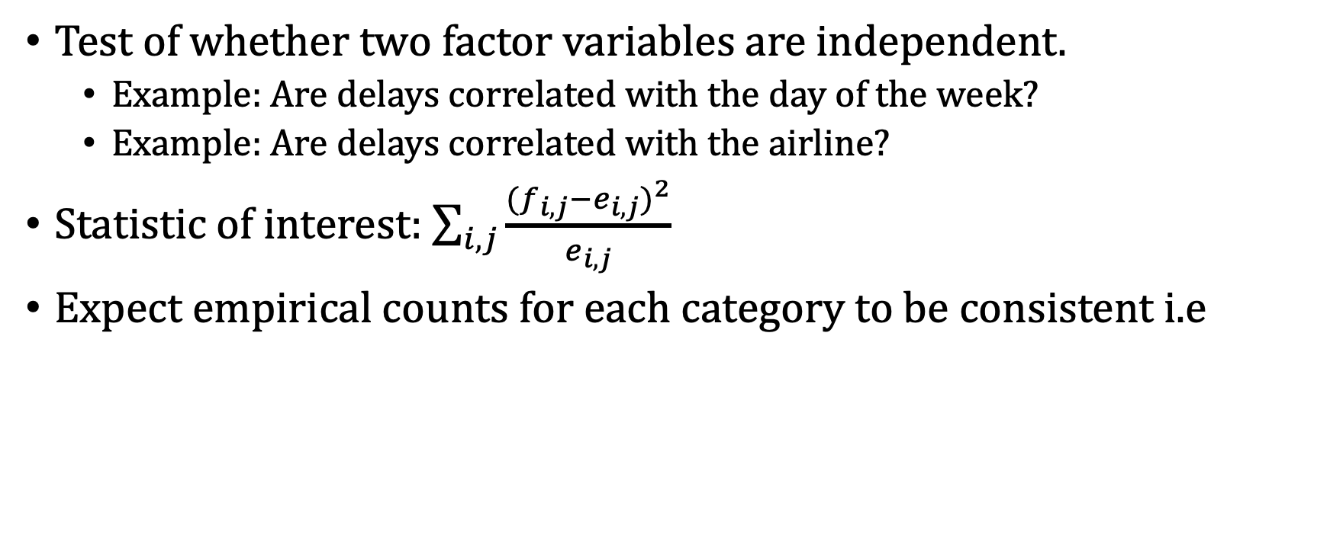
Chi-Squared Test for Two Variables
Test of whether two factor variables are independent.
Example: Are delays correlated with the day of the week?
Example: Are delays correlated with the airline?
Statistic of interest: $\sum_{i, j}{\frac{{{(f}_{i,j}−e_{i,j})}^{2}}{e_{i,j}}}$
Expect empirical counts for each category to be consistent i.e
table(flight_data$Day.of.Week, flight_data$Delay.indicator)
0 1
1 44 4
2 5 54
3 60 0
4 48 0
5 48 0
6 10 36
7 48 0
Null Hypothesis: Same Expected Proportions

Slide 17
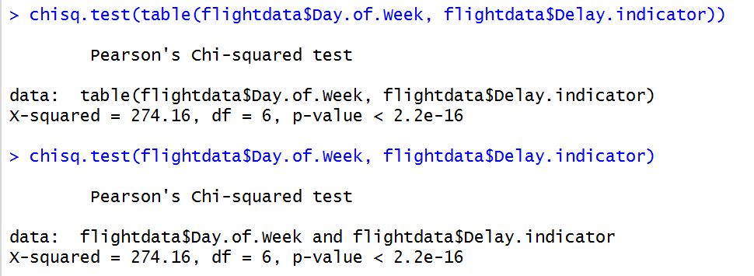
Example: Are delays related to the day of the week?
Single argument: a table of counts for 2 factors
2 arguments:
2 factors
Same Result
p-value < 2.2×10⁻¹⁶ (smallest p-value reported by R)
→ Flight delays are related to the day of the week (statistically significant result)

Slide 18
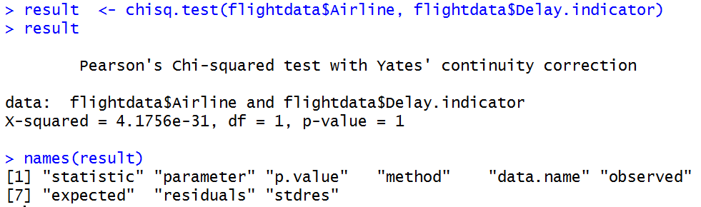
Example: Are delays related to airline?
Store result of chisq.test() function
Note this is a dataframe
p-value = 1 → delays are independent of airline.
Printing the names of results shows much more than the above output

Slide 19
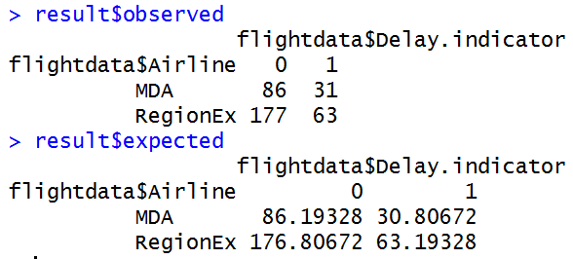
More Analysis on the Results
If we want to see the observed and expected counts, we can:
Notice that there is almost no difference between the two tables

Slide 20
Final Notes about Chi-Squared Test
Expected count in all cells should be at least five. This is because the test depends on asymptotic normality. In general the more observations you have per category the better it works!
Avoid using categories that are too narrow
You may opt to combine groups
Example: Aggregating different customer types into Whales and Minnows
Observations must fall into exactly one category, and no observations should be intentional excluded
You can do this against any table of expected values, not just uniform ones like we’ve seen

Slide 21
Topic: Testing Proportions
Set up: Consider a binary variable (i.e. two outcomes):
Example: Success or Failure
Example: Death or Survival
Example: Yes or No
Goal: Want to test if the proportion of successes (survivals, yes’s) in sample matches hypothesis proportion.
Example: The proportion of delayed flights (Delay.indicator = 1)
This can be thought of as the probability of a delay (~0.26 or 26%)

Slide 22
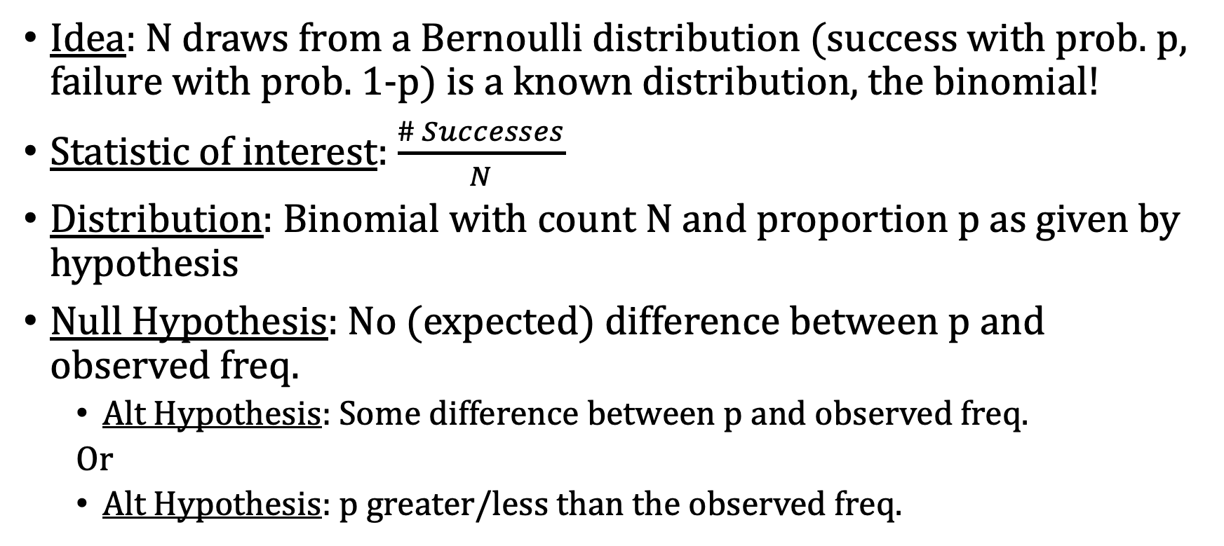
Topic: Binomial Test for Proportions
Idea: N draws from a Bernoulli distribution (success with prob. p, failure with prob. 1-p) is a known distribution, the binomial!
Statistic of interest: $\frac{\# Successes}{N}$
Distribution: Binomial with count N and proportion p as given by hypothesis
Null Hypothesis: No (expected) difference between p and observed freq.
Alt Hypothesis: Some difference between p and observed freq.
Or
Alt Hypothesis: p greater/less than the observed freq.

Slide 23
Comparing this proportion to some presupposed number
Suppose that 20% of flights were delayed in September 2008
Is 26% significantly different from 20%?
Can we obtain a plausible range for the proportion of delayed flights for October 2008? (95% confidence interval)
We can test both using a binomial test
binom.test() function in R

Slide 24
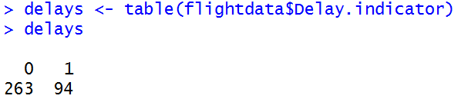
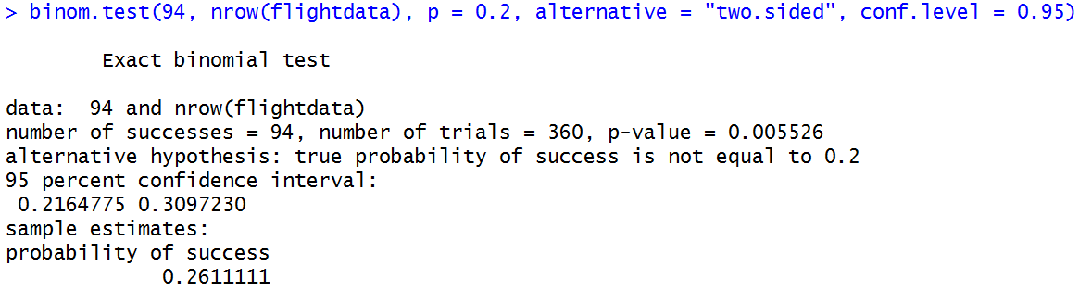
The binomial test in R via binom.test()
Compute number of delays (“successes”)
Number of “successes”
Sample size
Proportion that you are comparing to
What are you testing?
3 options: “greater”, “less”, “two.sided”
Confidence level (usually 95%)

Slide 25
Reading the binom.test() output
p-value → 26% is significantly different from 20%
Confidence Interval
What we are testing/trying to prove

Slide 26
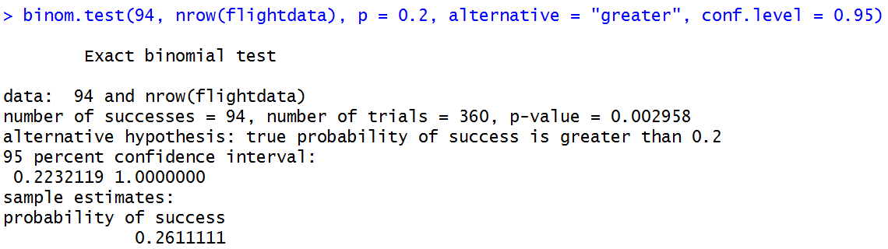
Example: What if we wanted to test if the observed delay rate was significantly higher than 20%?
Only difference in command
p-value changes (half of “two.sided” p-value)
Confidence interval looks different

Slide 27
Topic: Prop Test
Idea: Use the chi.sq test to see if proportion of a binary variable different between two groups
Statistic of interest: Same as before
Distribution: Binomial with count N and proportion p as given by the null hypothesis
Null Hypothesis: No (expected) difference between p and observed freq.
Alt Hypothesis: Some difference between p and observed freq.
Or
Alt Hypothesis: p greater/less than the observed freq.

Slide 28
Topic: Testing Proportions Across Two Groups
Example: Test the difference in the proportion of flight delays for two airlines .
Note this is a special case of the Chi-Squared Test! Why?
The null hypothesis implies an expected number of observations. We can thus apply the Chi-Squared test on the implied expected counts
We can do this with the prop.test() function in R
Syntax is very similar to the binom.test() function

Slide 29
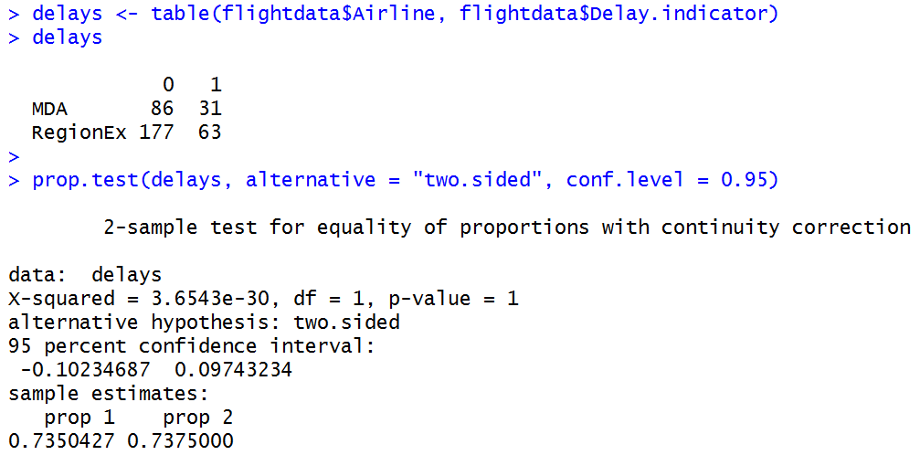
Using the prop.test() function
Create table of counts
Note group variable is first
Table of counts
p-value → group proportions not different
95% confidence interval for difference
Uses row 1 – row 2 (i.e., prop 1 – prop 2)

Slide 30
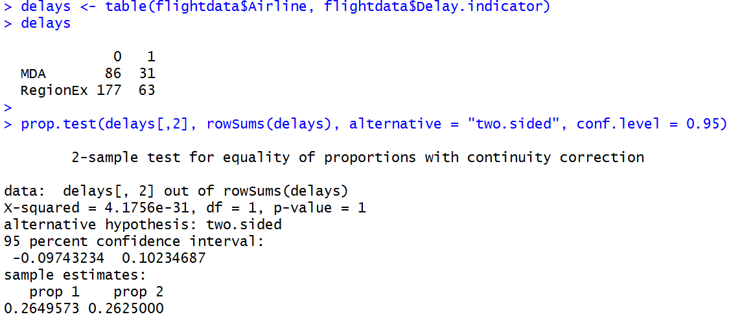
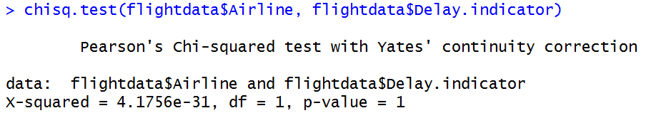
Notice similarities to Chi-squared test

Slide 31
For Next Time
Assignment 4 is posted! It’s about plotting due (9/18)
Assignment 3 is due on Friday (9/11)
Thanks! See you on Thursday!

